Slide 1


Recursion
Introduction to Computer Science
Reichman University
Lecture 7-1

Slide 2
Recursion
Recursive function: A function that operates on an input by calling itself to operate on a smaller version of that input
Example: n! = n * (n – 1)!
4! = 4 * 3! = 4 * 3 * 2! = 4 * 3 * 2 * 1! = 4 * 3 * 2 * 1
Recursive procedure: A procedure that solves a problem by applying itself to solve a smaller subset of that problem
Example: List the files and folders in a given folder
Recursive data structure: A data structure consisting of smaller parts that are the same data structure
Example: The string "abcd" can be viewed as the character 'a', followed by the string "bcd"
Recursion
An elegant way for modeling such cases
A fundamental CS concept and technique.

Slide 3
Example: factorial
factorial(5) = 5 * factorial(4) =
5 * (4 * factorial(3)) =
5 * 4 * (3 * factorial(2)) =
5 * 4 * 3 * (2 * factorial(1)) =
5 * 4 * 3 * 2 * (1 * 1) =
5 * 4 * 3 * 2 * 1 = 120
public class MyMath {
...
// Returns the factorial (n!) of the given n.
public static int factorial(int n) {
if (n == 1)
return 1;
else
return n * factorial(n – 1);
}
}
public class Foo
...
System.out.println("4! = " + MyMath.factorial(4));
System.out.println("10! = " + MyMath.factorial(10));
...
% java Foo
4! = 24
10! = 3628800

Slide 4
Factorial: run-time simulation
24
ז
factorial(4) = 4 * factorial(3)
א
6
ו
return 3 * factorial (2)
public class MyMath {
...
// Returns the factorial (n!) of the given n.
public static int factorial(int n) {
if (n == 1)
return 1;
else
return n * factorial(n – 1);
}
}
ב
2
ה
return 2 * factorial(1)
ג
1
ד
base case: return 1
public class Foo
...
System.out.println("4! = " + MyMath.factorial(4));
System.out.println("10! = " + MyMath.factorial(10));
...
% java Foo
4! = 24
10! = 3628800

Slide 5
Factorial: run-time simulation
Function call and return:
When function f calls function g, the parameters and local variables of f (in this case: n) are put on hold
When g returns, the parameters and local variables of f are re-instantiated, and its execution resumes
In recursion, f and g are two instances of the same function
Each recursive call is handled as a separate and independent function call.
24
ז
factorial(4) = 4 * factorial(3)
א
6
ו
return 3 * factorial (2)
ב
2
ה
return 2 * factorial(1)
ג
1
ד
base case: return 1
// Returns the factorial (n!) of the given n.
public static int factorial(int n) {
if (n == 1)
return 1;
else
return n * factorial(n-1);

Slide 6
Recursive and iterative implementations
// Returns the factorial (n!) of the given n.
public static int factorial(int n) {
if (n == 1)
return 1;
else
return n * factorial((n – 1));
}
}
// Returns the factorial (n!) of a given n.
public static long factorial (int n) {
int fact = 1;
for (int i = 1; i <= n; i++) {
fact *= i;
}
return fact;
}
recursive implementation
iterative implementation
Every recursive implementation has an equivalent iterative implementation
The recursive implementation is often more elegant
The iterative implementation looks more efficient
But, good compilers generate low-level code that converts recursive implementations into iterative implementations.

Slide 7
Recursive intuition
Recursive intuition and algorithms are based on three elements:
Reduction: Reduce the original problem into a smaller / simpler sub-problem
Base case: At some point the reduction must arrive to a sub-problem that can be solved directly
Combination: Combining the current “level” with results returned by the level below.
// Returns the factorial (n!) of the given n.
public static int factorial(int n) {
if (n == 1)
return 1;
else
return n * factorial((n – 1));
}
}
base case
combination
reduction

Slide 8
Plan
Recursive functions (examples)
Factorial
String processing
Fibonacci
Power
Recursive procedures (examples)
Printing
Fractals
Permutations

Slide 9
Reversing a string
Task: reverse a string
Example: reverse("abcd") should return "dcba"
Insight: reverse("abcd") = reverse("bcd") + 'a'

Slide 10
Reversing a string
Task: reverse a string
Example: reverse("abcd") should return "dcba"
Insight: reverse("abcd") = reverse("bcd") + ‘a’
reverse("a") = "a"

Slide 11
Reversing a string
Task: reverse a string
Example: reverse("abcd") should return "dcba"
Insight: reverse("abcd") = reverse("bcd") + ‘a’
reverse("a") = "a"
Recursive algorithm for reverse(str):
If str consists of a single character, or null, return str
else return reverse (the last n – 1 characters of str) + str[0]
public static String reverse(String str) {
if (str.length() <= 1) {
return str;
}
return reverse(str.substring(1)) + str.charAt(0);
}
base case
substring(1): All the characters beginning in index 1
reduction
combination

Slide 12
Reversing a string: Simulation
Typical recursive execution pattern:
The problem is reduced “on the way down” (by the recursive calls)
The solution is assembled “on the way up” (using the return values).
reverse("abcd")
א
dcba
ח
return reverse("bcd") + 'a'
ב
dcb
ז
return reverse("cd") + 'b'
ג
dc
ו
public static String reverse(String str) {
if (str.length() <= 1) {
return str;
}
return reverse(str.substring(1)) + str.charAt(0);
}
return reverse("d") + 'c'
ד
d
ה
return "d"

Slide 13
Plan
Recursive functions (examples)
Factorial
String processing
Fibonacci
Power
Recursive procedures (examples)
Printing
Fractals
Permutations

Slide 14
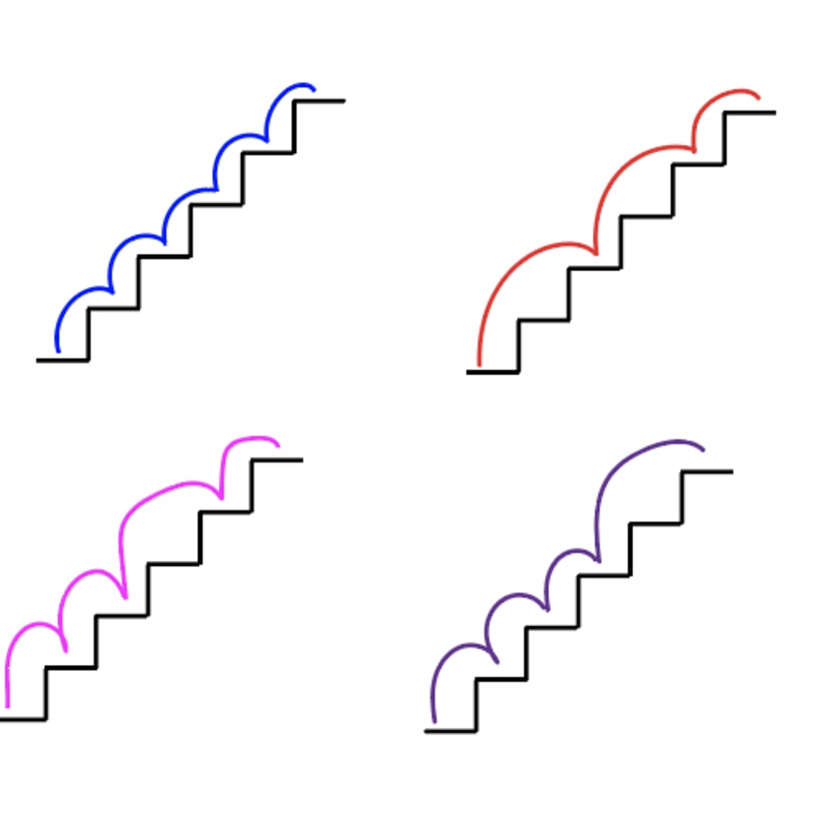
Fibonacci
When climbing a staircase, you are allowed to climb either 1 stair, or 2 stairs, in each step:
... many other ways to climb n stairs. How many?
f (n) = number of different ways to reach stair n
Insight:
You reach step n either from stair n – 1, or from stair n – 2; Therefore:
f (n) = f (n – 1) + f (n – 2)
Base cases
f (1) = 1
f (0) = 1

Slide 15
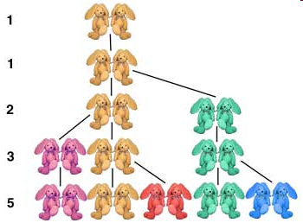
Fibonacci
Fibonacci series definition
f (0) = 1
f (1) = 1
f (n) = f (n – 1) + f (n – 2) for all n > 1
The staircase problem is one out of numerous settings in nature and in engineering in which the Fibonacci series comes up.
The Fibonacci series: 1, 1, 2, 3, 5, 8, 13, ...
0
1
2
3
4
From generation 1 onward, in each generatuion, each pair of rabbits give birth to a pair of rabbits.
f (n) = number of pairs of rabbits in generation n

Slide 16
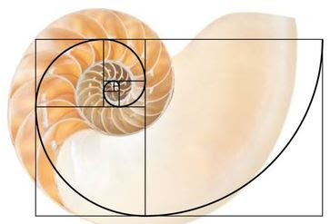
Fibonacci
Fibonacci series definition
f (0) = 1
f (1) = 1
f (n) = f (n – 1) + f (n – 2) for all n > 1
The staircase problem is one out of numerous settings in nature and in engineering in which the Fibonacci series comes up.
The Fibonacci series: 1, 1, 2, 3, 5, 8, 13, ...
f (n) = square length in stage n

Slide 17
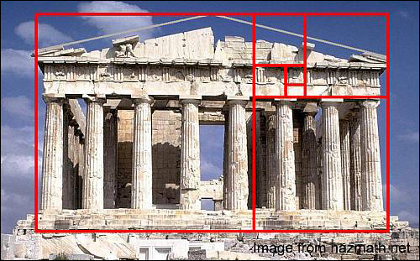
Fibonacci
Fibonacci series definition
f (0) = 1
f (1) = 1
f (n) = f (n – 1) + f (n – 2) for all n > 1
The staircase problem is one out of numerous settings in nature and in engineering in which the Fibonacci series comes up.
The Fibonacci series: 1, 1, 2, 3, 5, 8, 13, ...
f (n) = square length in stage n

Slide 18
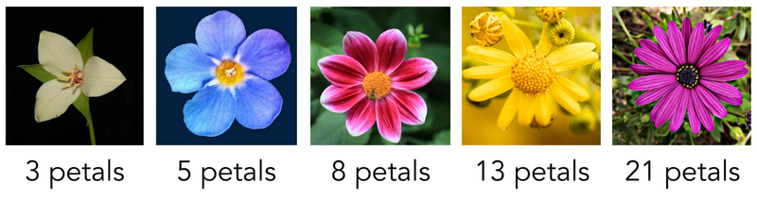
Fibonacci
Fibonacci series definition
f (0) = 1
f (1) = 1
f (n) = f (n – 1) + f (n – 2) for all n > 1
The staircase problem is one out of numerous settings in nature and in engineering in which the Fibonacci series comes up.
The Fibonacci series: 1, 1, 2, 3, 5, 8, 13, ...
Number of petals in flowers = Fibonacci numbers

Slide 19
Fibonacci
Fibonacci series definition
f (0) = 1
f (1) = 1
f (n) = f (n – 1) + f (n – 2) for all n > 1
The staircase problem is one out of numerous settings in nature and in engineering in which the Fibonacci series comes up.
The Fibonacci series: 1, 1, 2, 3, 5, 8, 13, ...

Slide 20
Fibonacci
Fibonacci series definition
f (0) = 1
f (1) = 1
f (n) = f (n – 1) + f (n – 2) for all n > 1
The staircase problem is one out of numerous settings in nature and in engineering in which the Fibonacci series comes up.
The Fibonacci series: 1, 1, 2, 3, 5, 8, 13, ...
// Returns the n'th fibonacci number
public static int fibonacci1(int n) {
if (n <= 1) return n;
int f, fprev = 1, fprevprev = 1;
for (int i = 2; i <= n; i++) {
f = fprev + fprevprev;
fprevprev = fprev;
fprev = f;
}
return f;
}
Iterative implementation
public class Foo
...
System.out.println(MyMath.fibonacci1(40));
...
% java Foo
102334155

Slide 21
Fibonacci
Fibonacci series definition
f (0) = 1
f (1) = 1
f (n) = f (n – 1) + f (n – 2) for all n > 1
The Fibonacci series: 1, 1, 2, 3, 5, 8, 13, ...
// Returns the n'th fibonacci number
public static int fibonacci(int n) {
if (n <= 1) return n;
return fibonacci(n – 1) + fibonacci(n – 2);
}
Recursive implementation
public class Foo
...
System.out.println(MyMath.fibonacci(40));
...
% java Foo
102334155

Slide 22
Fibonacci : performance issues
Recursive solution
Iterative solution
// Returns the n'th fibonacci number
public static int fibonacci(int n) {
if (n <= 1) return n;
return fibonacci(n – 1) + fibonacci(n – 2);
}
// Returns the n'th fibonacci number
public static int fibonacci1(int n) {
if (n <= 1) return n;
int f, fprev = 1, fprevprev = 1;
for (int i = 2; i <= n; i++) {
f = fprev + fprevprev;
fprevprev = fprev;
fprev = f;
}
return f;
}
Running time
The computation of fibonacci(n) requires... Let’s see...
Running time
The computation of fibonacci1(n) requires n iterations
(linear running time)
not bad

Slide 23
Fibonacci : performance issues
Recursive solution
f(4)
// Returns the n'th fibonacci number
public static int fibonacci(int n) {
if (n <= 1) return n;
return fibonacci(n – 1) + fibonacci(n – 2);
}
f(3)
f(2)
f(2)
f(1)
f(1)
f(0)
Running time
The computation of fibonacci(n) requires... Let’s see...
f(1)
f(0)

Slide 24
Fibonacci : performance issues
Recursive solution
f(4)
// Returns the n'th fibonacci number
public static int fibonacci(int n) {
if (n <= 1) return n;
return fibonacci(n – 1) + fibonacci(n – 2);
}
f(3)
f(2)
f(2)
f(1)
f(1)
f(0)
Massive redundancy:
for example, f(2)
is computed twice
Running time
The computation of fibonacci(n) requires 2^{n} iterations
f(1)
f(0)
unrealistic
(exponential running time)
Optimizing recursive solutions:
Memoization: After computing f (n), store it, for re-use.

Slide 25
Plan
Recursive functions (examples)
Factorial
String processing
Fibonacci
Power
Recursive procedures (examples)
Printing
Fractals
Permutations

Slide 26

Power: $x^{n}$
power (x , 0) = 1
power (x , n) = x * power (x , n – 1) for n > 0
power(3 , 4)
א
81
ח
// Returns x raised to the power of n
public static int power(int x, int n) {
if (n == 0) return 1;
return x * power(x, n – 1);
}
3 * power (3 , 3)
ב
27
ז
3 * power(3, 2)
ג
9
ו
Running time
The computation of power(x,n) requires n steps (recursive calls)
(linear running time)
3 * power(3 , 1)
ד
3
ה
3 * power(3 , 0)
Can we do better?

Slide 27

Power: $x^{n}=$ $x^{\frac{n}{2}}∙$ $x^{\frac{n}{2}}$ (improved version)
// Returns x raised to the power of n
// (efficient implementation)
public static int power1(int x, int n) {
if (n == 0) return 1;
if ((n % 2) == 0) {
int t = power1(x, n/2);
return t * t;
}
return x * power1(x, n – 1);
}
power1(3 , 5)
א
243
ח
return 3 * power1(3 , 4)
ב
81
ז
t = power1(3 , 2), return t * t
Running-time
In each step we either call power1(x, n / 2), or we call power1(x, n – 1)
How many times can n be divided by 2? log₂n times
ג
9
ו
t = power1(3 , 1), return t * t
ד
3
ה
return 3 * power1(3 , 0)

Slide 28
Power: $x^{n}=$ $x^{\frac{n}{2}}∙$ $x^{\frac{n}{2}}$ (improved version)
// Returns x raised to the power of n
// (efficient implementation)
public static int power1(int x, int n) {
if (n == 0) return 1;
if ((n % 2) == 0) {
int t = power1(x, n/2);
return t * t;
}
return x * power1(x, n – 1);
}
power1(3 , 5)
א
243
ח
return 3 * power1(3 , 4)
ב
81
ז
t = power1(3 , 2), return t * t
Running-time
In each step we either call power1(x, n / 2), or we call power1(x, n – 1)
How many times can n be divided by 2? log₂n times
The running time is at most log₂n steps (recursive calls)
(logarithmic running time)
ג
9
ו
t = power1(3 , 1), return t * t
ד
3
ה
return 3 * power1(3 , 0)
Wow

Slide 29
Power: $x^{n}=$ $x^{\frac{n}{2}}∙$ $x^{\frac{n}{2}}$ (improved version)
// Returns x raised to the power of n
// (efficient implementation)
public static int power1(int x, int n) {
if (n == 0) return 1;
if ((n % 2) == 0) {
int t = power1(x, n/2);
return t * t;
}
return x * power1(x, n – 1);
}
How can we “trust” a program (in general)
Program testing (empirical)
Program verification, by proof (formal).
Theorem: For any x and positive integer n, the algorithm returns x^{n}
Proof: (by induction)
Base case: if n = 0 the algorithm returns 1.
Inductive hypothesis: assume that for all k < n the algorithm returns x ^{k}
Inductive step:
If n is even, the algorithm returns power(x, n/2) * power(x, n/2);
By the induction hypothesis, power(x, n/2) returns x ^{½ n}.
Therefore, the algorithm returns (x ^{½ n} ) * (x ^{½ n} ) = x ^{n}
If n is odd, the algorithm returns x * power (x, n-1);
By the induction hypothesis, power (x, n-1) returns x ^{n-1}.
Therefore, the algorithm returns x * (x ^{n-1} ) = x ^{n} .

Slide 30
Plan
Recursive functions (examples)
Factorial
String processing
Fibonacci
Power
Recursive procedures (examples)
Printing
Fractals
Permutations

Slide 31
Print, reversed
Print reverse:
// Inputs numbers from the user;
// When 0 is entered, prints the numbers, in reverse
private static void printReverse() {
% java PrintReverse
Enter a number: 5
Enter a number: 2
Enter a number: 7
Enter a number: 0
7
2
5

Slide 32
Print, reversed
Print reverse:
Suppose that the user inputs: 5, 2, 7, 0
// Inputs numbers from the user;
// When 0 is entered, prints the numbers, in reverse
private static void printReverse() {
In in = new In();
System.out.print("Enter a number: ");
int x = in.readInt();
if (x != 0) {
printReverse();
System.out.println(x);
}
}
read(x) (now x=5) printReverse() print(x)
א
ו
read(x) (now x=2) printReverse() print(x)
ב
ה
read(x) (now x=7) printReverse() print(x)
% java PrintReverse
Enter a number: 5
Enter a number: 2
Enter a number: 7
Enter a number: 0
7
2
5
ג
ד
read(x) (now x=0) (return)
x is a local variable; each level has its own local variables
When we make a function call, x is put “on hold”
When we return, we revisit these x values, and print them

Slide 33
Print, reversed
Print reverse:
Print reverse, reversed:
// Inputs numbers from the user;
// When 0 is entered, prints the numbers, in reverse
private static void printReverse() {
In in = new In();
System.out.print("Enter a number: ");
int x = in.readInt();
if (x != 0) {
printReverse();
System.out.println(x);
}
}
// Read and print numbers,
// until 0 is entered
private static void printReverse1() {
In in = new In();
System.out.print("Enter a number: ");
int x = in.readInt();
if (x != 0) {
System.out.println(x);
printReverse1();
}
}
Enter a number: 5
5
Enter a number: 2
2
Enter a number: 7
7
Enter a number: 0
Recursive version of a while loop
In principle, every loop can be implemented recursively

Slide 34
Plan
Recursive functions (examples)
Factorial
String processing
Fibonacci
Power
Recursive procedures (examples)
Printing
Fractals
Permutations

Slide 35

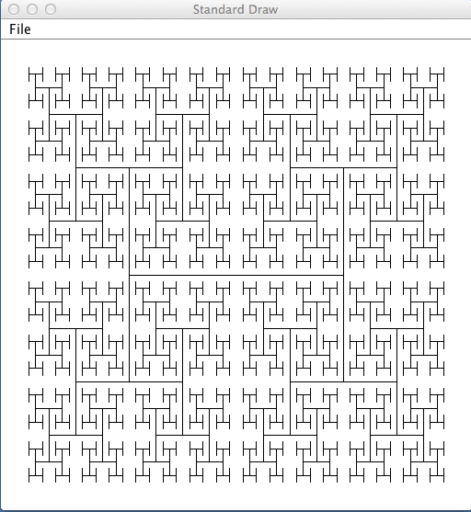
Fractal drawing

Slide 36
Fractal drawing
Task: draw a “fractal H figure”

Slide 37

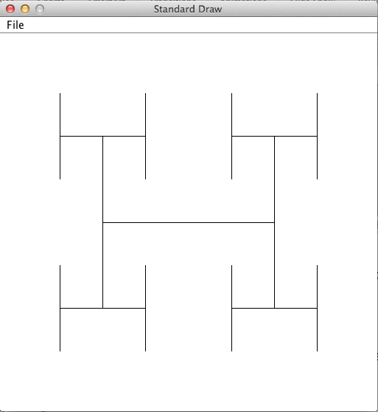
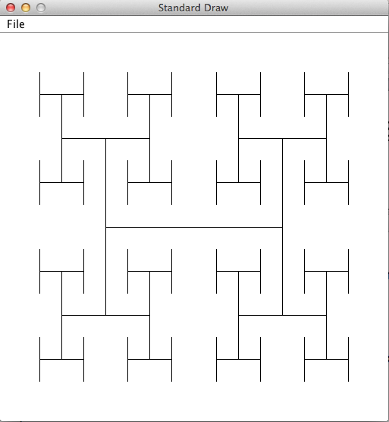

Fractal drawing
Task: draw a “fractal H figure”
Draw an H figure of a given size, centered at (x,y)
Draw 4 H figures of half the size, centered at the 4 tips of the H
Draw 4 H figures of half the size, centered at the 4 tips of every H
Etc.
(x,y)
size

Slide 38
Fractal drawing
Task: draw a “fractal H figure”
Draw an H figure of a given size, centered at (x,y)
Draw 4 H figures of half the size, centered at the 4 tips of the H
Draw 4 H figures of half the size, centered at the 4 tips of every H
Etc.
public static void drawH(double x, double y, double size) {
( x₀,y₁)
( x₁,y₁)
½ size
(x,y)
( x₀,y)
( x₁,y)
size
( x₀,y₀)
( x₁,y₀)

Slide 39
Fractal drawing
Task: draw a “fractal H figure”
Draw an H figure of a given size, centered at (x,y)
Draw 4 H figures of half the size, centered at the 4 tips of the H
Draw 4 H figures of half the size, centered at the 4 tips of every H
Etc.
public static void drawH(double x, double y, double size) {
double x0 = x – size/2, x1 = x + size/2;
double y0 = y – size/2, y1 = y + size/2;
// Draws the H figure
StdDraw.line(x0, y, x1, y);
StdDraw.line(x0, y0, x0, y1);
StdDraw.line(x1, y0, x1, y1);
// Draws 4 H figures of half the size, at the
// four tips of the current H figure
drawH(x0, y0, size/2);
drawH(x0, y1, size/2);
drawH(x1, y0, size/2);
drawH(x1, y1, size/2);
}
( x₀,y₁)
( x₁,y₁)
½ size
(x,y)
( x₀,y)
( x₁,y)
size
( x₀,y₀)
( x₁,y₀)

Slide 40
Fractal drawing
Task: draw a “fractal H figure”
Draw an H figure of a given size, centered at (x,y)
Draw 4 H figures of half the size, centered at the 4 tips of the H
Draw 4 H figures of half the size, centered at the 4 tips of every H
Etc.
public static void drawH(double x, double y, double size) {
double x0 = x – size/2, x1 = x + size/2;
double y0 = y – size/2, y1 = y + size/2;
// Draws the H figure
StdDraw.line(x0, y, x1, y);
StdDraw.line(x0, y0, x0, y1);
StdDraw.line(x1, y0, x1, y1);
// Draws 4 H figures of half the size, at the
// four tips of the current H figure
drawH(x0, y0, size/2);
drawH(x0, y1, size/2);
drawH(x1, y0, size/2);
drawH(x1, y1, size/2);
}
drawH(.5, .5, .5)
(we draw an H-fractal in the unit square. The figure is centered at (.5,.5), and its size is 0.5.
H-fractal of endless depth
Needed: a “base case” that stops the recursion

Slide 41
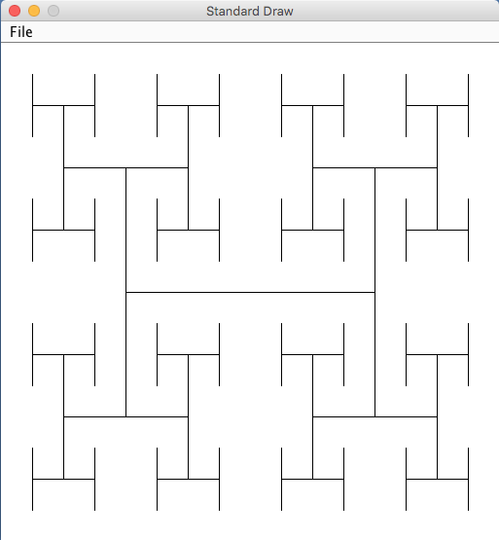
Fractal drawing
public static void test() {
// Draws an H-fractal of depth 3, in the unit square.
// The figure will be centered at (.5,.5), and its size will be 0.5.
drawH(.5, .5, .5, 3);
}
H-fractal of depth n = 3

Slide 42
Fractal drawing
public static void test() {
// Draws an H-fractal of depth 3, in the unit square.
// The figure will be centered at (.5,.5), and its size will be 0.5.
drawH(.5, .5, .5, 3);
}
// Draws an H-fractal, centered at x,y, of the given size and depth.
public static void drawH(double x, double y, double size, int n) {
if (n == 0) return;
double x0 = x - size/2, x1 = x + size/2;
double y0 = y - size/2, y1 = y + size/2;
// Draws the H figure
StdDraw.line(x0, y, x1, y);
StdDraw.line(x0, y0, x0, y1);
StdDraw.line(x1, y0, x1, y1);
// Draws 4 H figures of half the size,
// located at the 4 tips of the current H figure
drawH(x0, y0, size/2, n – 1);
drawH(x0, y1, size/2, n – 1);
drawH(x1, y0, size/2, n – 1);
drawH(x1, y1, size/2, n – 1);
}
H-fractal of depth n = 3

Slide 43
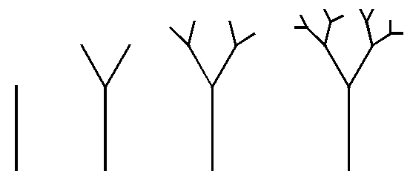

Fractal trees

Slide 44

Fractal trees, with noise

Slide 45

Computer generated landscapes

Slide 46
Plan
Recursive functions (examples)
Factorial
String processing
Fibonacci
Power
Recursive procedures (examples)
Printing
Fractals
Permutations

Slide 47
Permutations
Recursive insight
List all the strings that start with "a", followed by all the permutations of "bcd"
List all the strings that start with "b", followed by all the permutations of "acd"
List all the strings that start with "c", followed by all the permutations of "abd"
List all the strings that start with "d", followed by all the permutations of "abc"
listPerms("abcd"):
abcd
abdc
acbd
acdb
adbc
adcb
bacd
badc
bcad
bcda
bdac
bdca
cabd
cadb
cbad
cbda
cdab
cdba
dabc
dacb
dbac
dbca
dcab
dcba

Slide 48
Permutations
// Prints all the permutations of s
public static void listPerms (String s) {
listPerms("", s);
}
// Prints the given prefix, followed by all the permutations of s
private static void listPerms (String prefix, String s) {

Slide 49
Permutations
// Prints all the permutations of s
public static void listPerms (String s) {
listPerms("", s);
}
// Prints the given prefix, followed by all the permutations of s
private static void listPerms (String prefix, String s) {
if (s.length() == 0)
System.out.println(prefix);
else
for (int i = 0; i < s.length(); i++) {
// ch = i'th character of the string s
char ch = s.charAt(i);
// rest = s minus ch
String rest = s.substring(0, i) + s.substring(i + 1);
listPerms(prefix + ch, rest);
}
}
}
listPerms("abc"):
calling listPerms(a, bc)
// Debugging print:
System.out.println("calling listPerms(" + (prefix + ch) + ", " + rest + ")");

Slide 50
Permutations
// Prints all the permutations of s
public static void listPerms (String s) {
listPerms("", s);
}
// Prints the given prefix, followed by all the permutations of s
private static void listPerms (String prefix, String s) {
if (s.length() == 0)
System.out.println(prefix);
else
for (int i = 0; i < s.length(); i++) {
// ch = i'th character of the string s
char ch = s.charAt(i);
// rest = s minus ch
String rest = s.substring(0, i) + s.substring(i + 1);
listPerms(prefix + ch, rest);
}
}
}
listPerms("abc"):
calling listPerms(a, bc)
calling listPerms(ab, c)
calling listPerms(abc, )
abc
calling listPerms(ac, b)
calling listPerms(acb, )
acb
calling listPerms(b, ac)
calling listPerms(ba, c)
calling listPerms(bac, )
bac
calling listPerms(bc, a)
calling listPerms(bca, )
bca
calling listPerms(c, ab)
calling listPerms(ca, b)
calling listPerms(cab, )
cab
calling listPerms(cb, a)
calling listPerms(cba, )
cba
// Debugging print:
System.out.println("calling listPerms(" + (prefix + ch) + ", " + rest + ")");

Slide 51
Recursion
Introduction to Computer Science
Reichman University
Lecture 7-1

